Slide 1
HOTEL BOOKING DEMAND

Slide 2
CONTENTS
OBJECTIVE
ANALYTICAL OVERVIEW
TIME SERIES ANALYSIS
PREDICT CANCELLATION
PREDICT SPECIAL REQUESTS
MODEL COMPARISIONS
CONCLUSIONS
EXPLORATORY DATA ANALYSIS

Slide 3
ANALYTICAL OVERVIEW
Source of Dataset
Data Understanding
Data Cleaning
Time Series Analysis
MLR , Logistic Regression
Data Definition
Data Preparation
Data Analysis
Machine Learning Models
Data Formatting

Slide 4
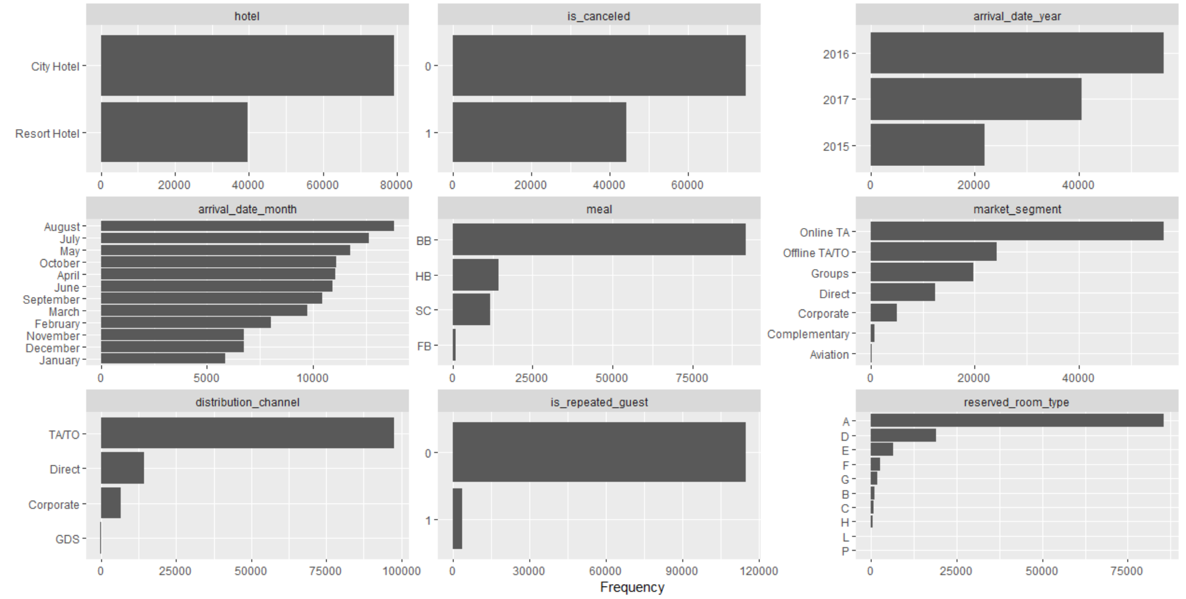
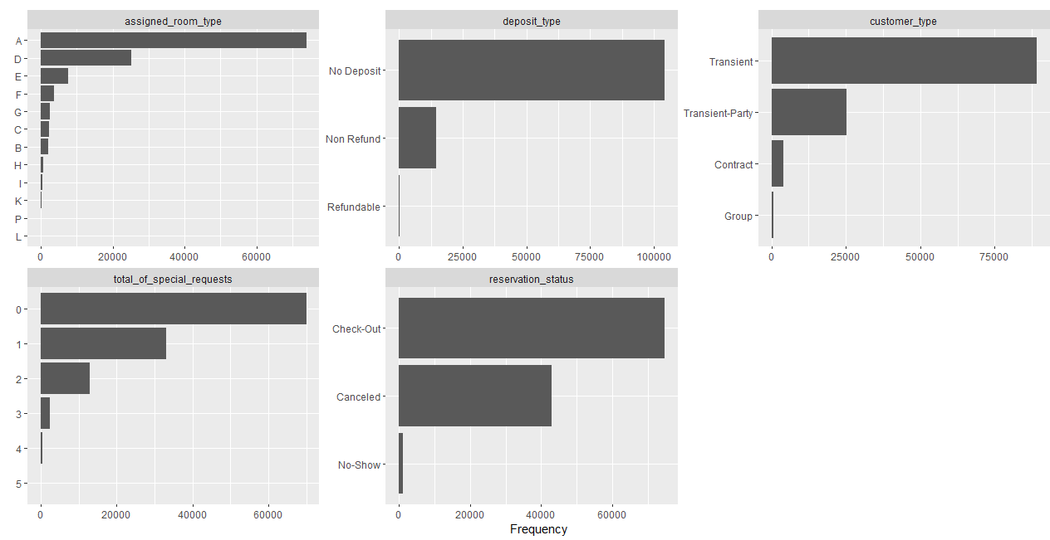
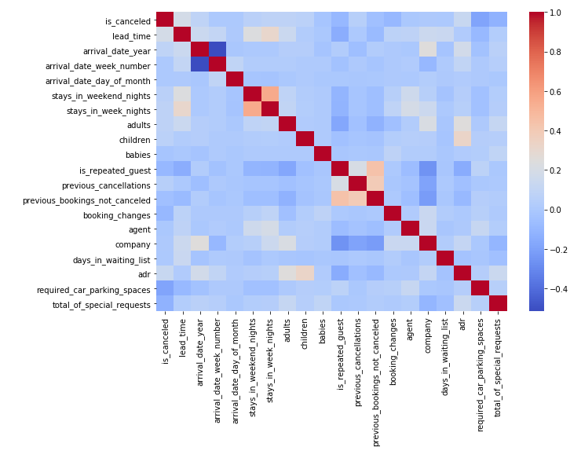
EXPLORATORY DATA ANALYSIS
Categorical Data and Continuous Data analyzed. Univariant, Bivariant and multivariant analysis performed.
Analyzed to check the seasonal trend in the dataset.

Slide 5
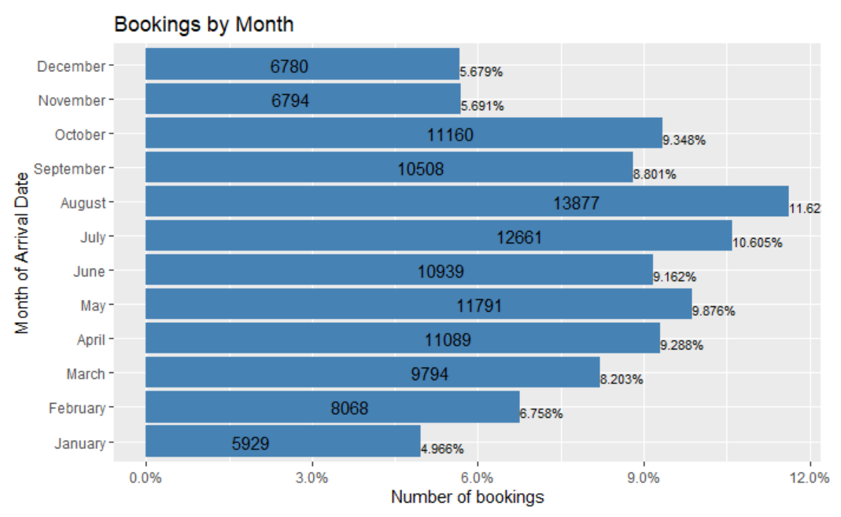
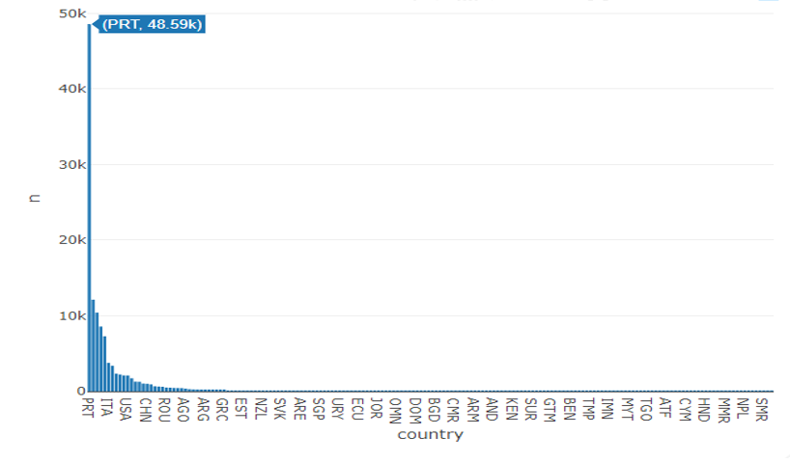
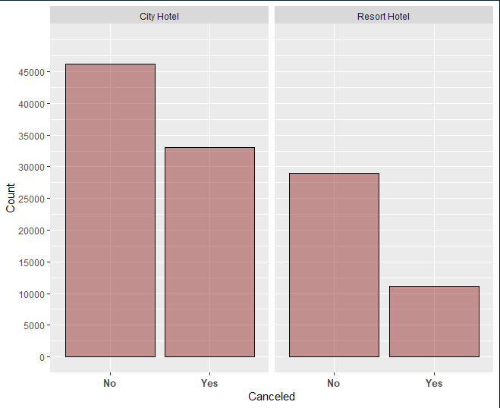
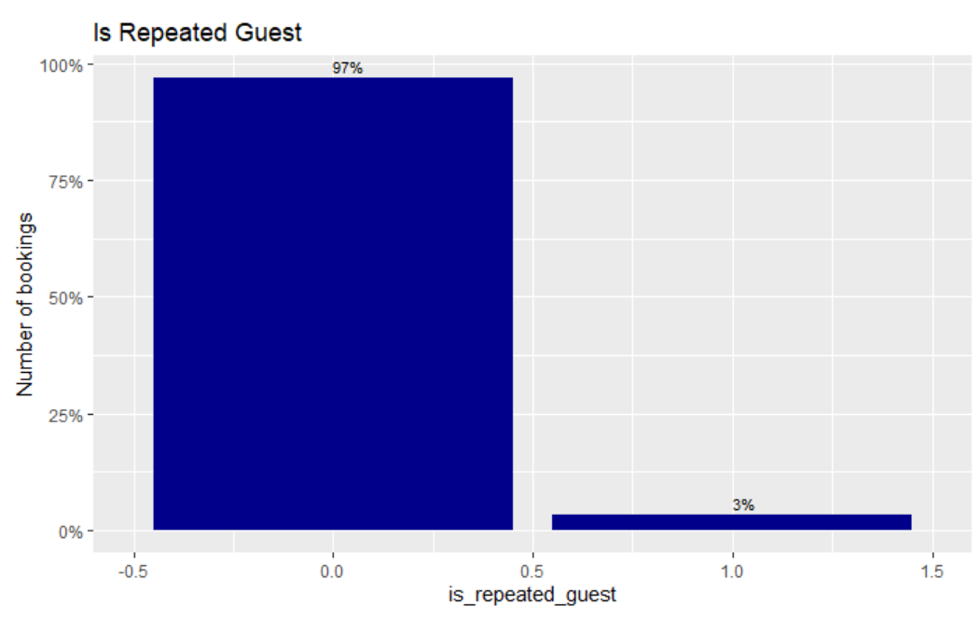
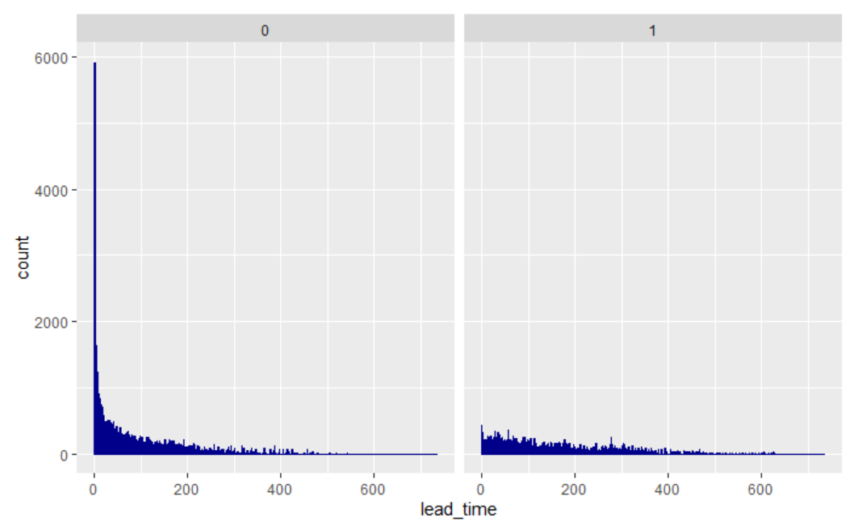
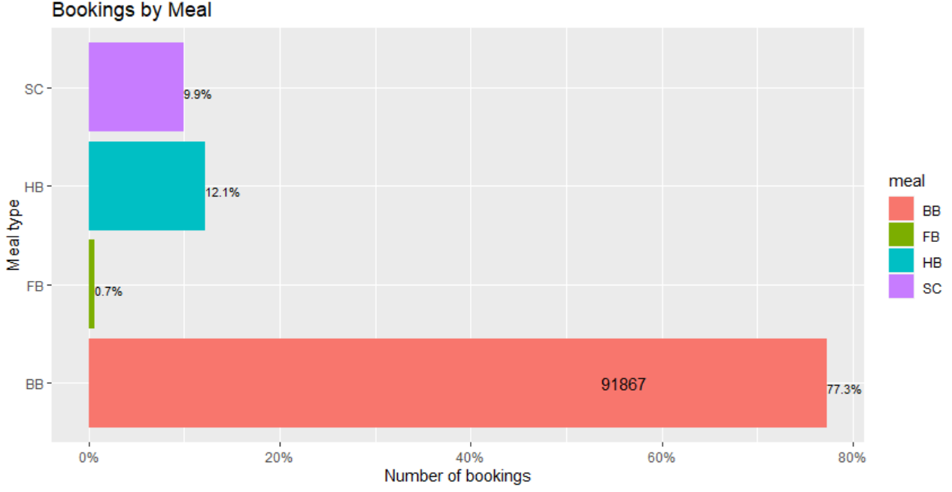
Notes:
Highest Bookings in the month of July and August and lowest in January.
Customers preferred City hotel than the Resort hotel with 41.7% ,21.7% cancellations
Chances of cancellations are less when the lead time of booking is less.
4.Bookings are mostly with European countries, with Portugal as highest with 48.59k bookings.
5.77% of the bookings are made with bed and breakfast.
6. 3% are repeated guests.

Slide 6
TIME SERIES ANALYSIS
Train the data to a time series data set
Test the Time Series Data
Decompose Seasonality
Smooth the data
Forecasts using Holtwinters,ETS,ARIMA,MLR
Validate the models
Predict the bookings for the next season

Slide 7
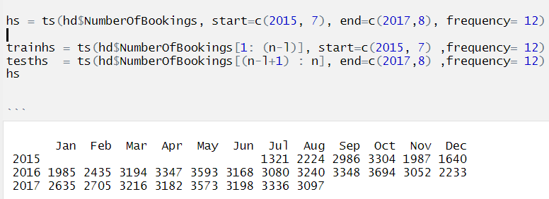
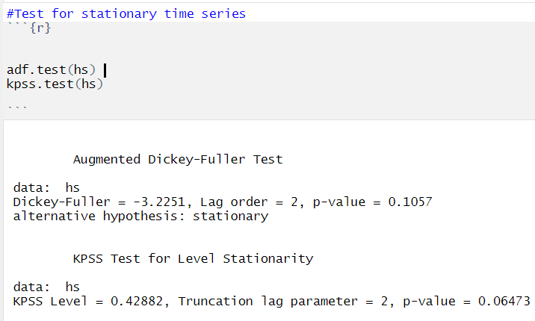
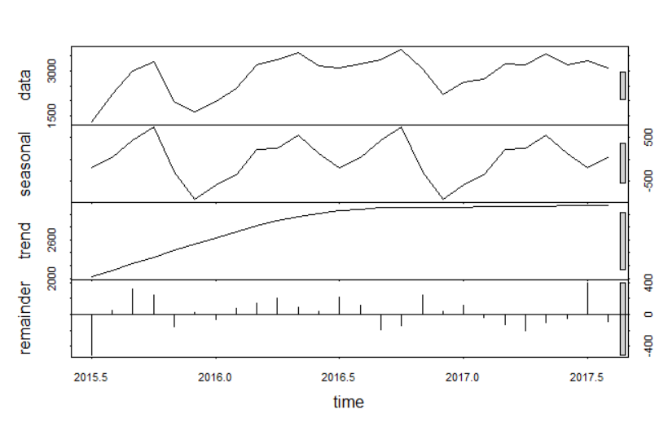

Slide 8
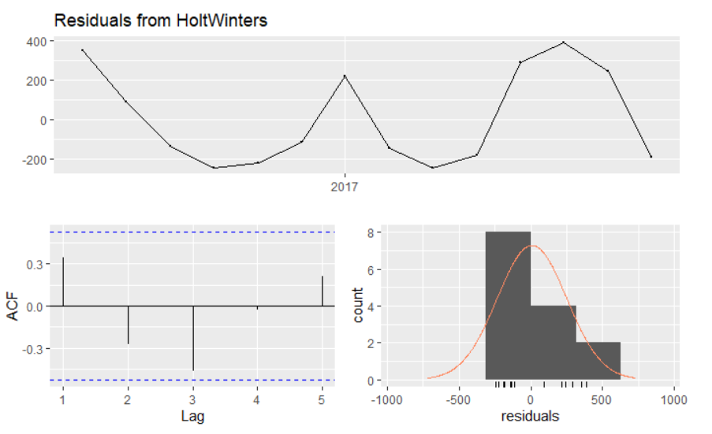
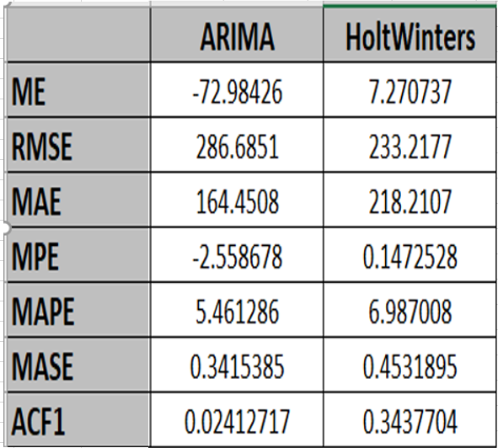
Model Comparison:

Slide 9
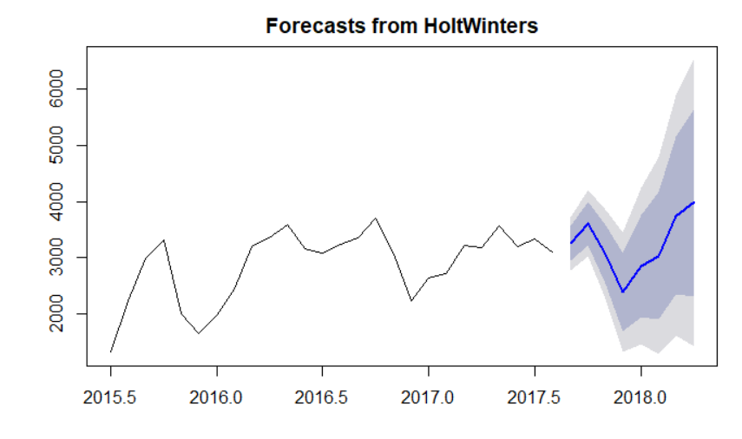
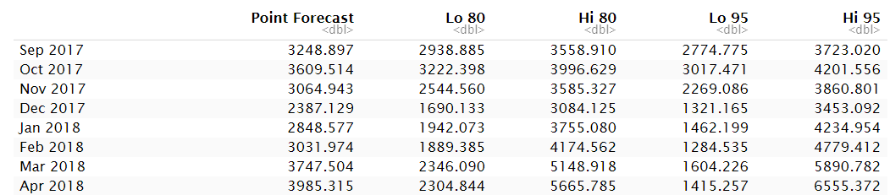
HoltWinters Forecast :

Slide 10
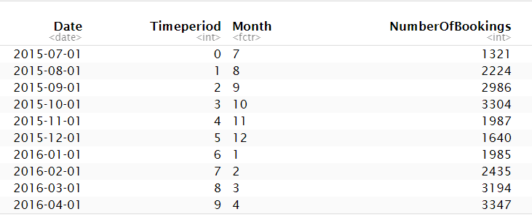
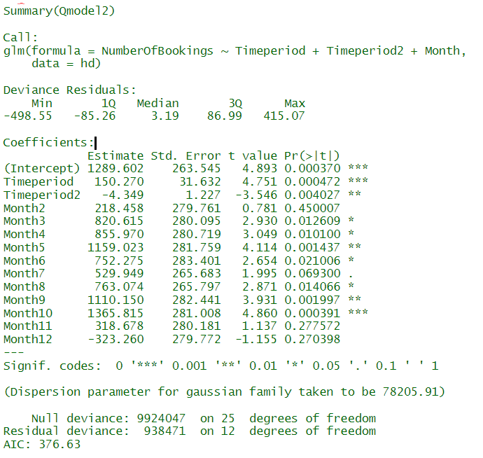
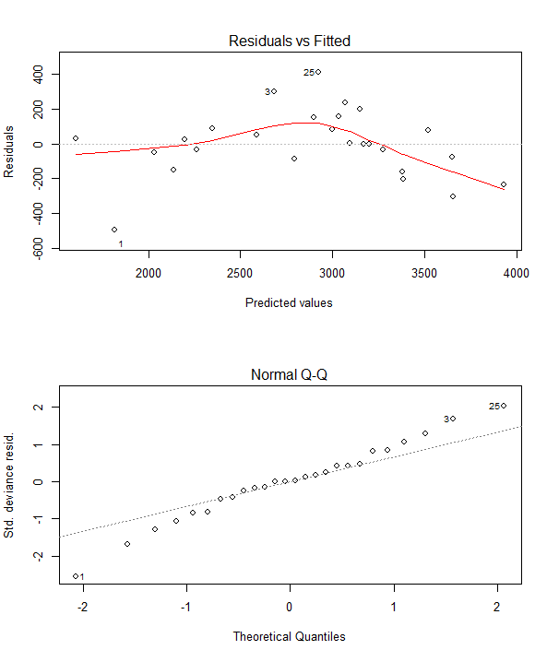
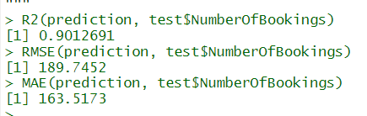
MLR using seasonality

Slide 11
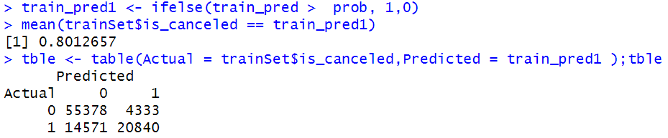
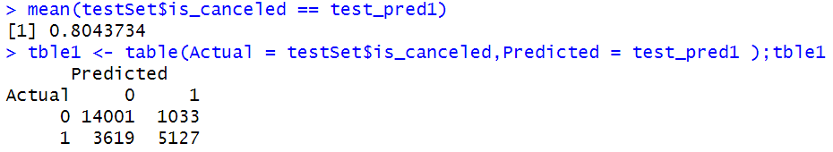
MODEL BUILDING - BOOKING CANCELLATIONS
1.USING MULTIPLE LOGISTIC REGRESSION
80.4% accuracy in predicting the model with testing dataset.
LIMITATIONS
Selection of variables is practically difficult and execution time is high with large datasets.

Slide 12
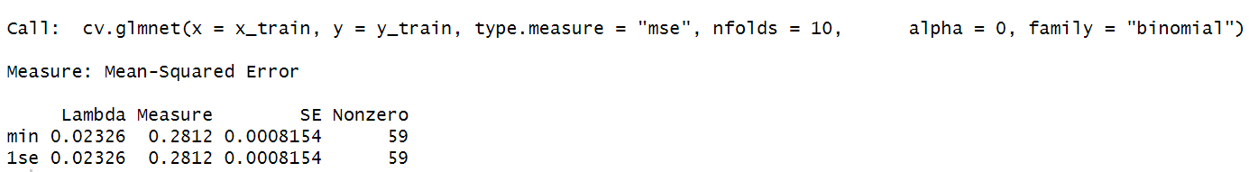
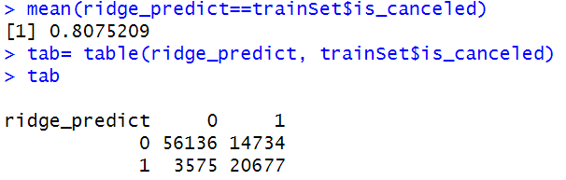
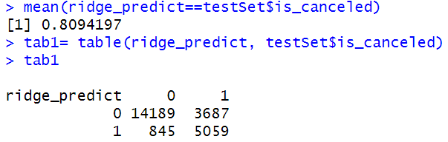
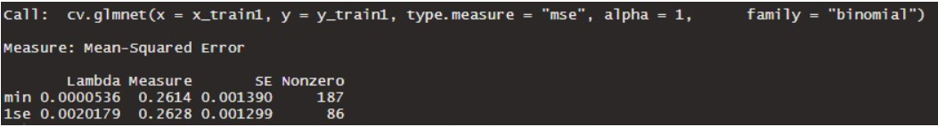

2. RIDGE REGRESSION
80.9% accuracy in predicting the model with testing dataset.
3. LASSO REGRESSION
80.57% accuracy in predicting the model with testing dataset.
Prepared the confusion matrix to evaluate the performance of the model.

Slide 13
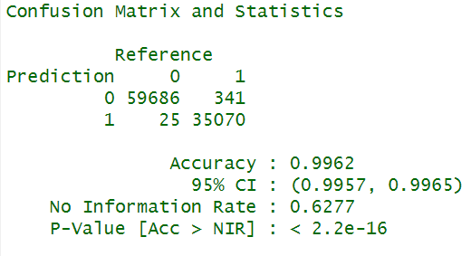
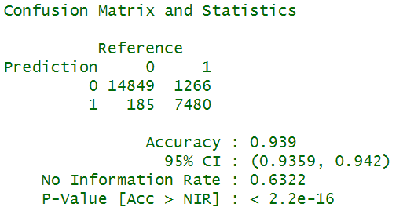
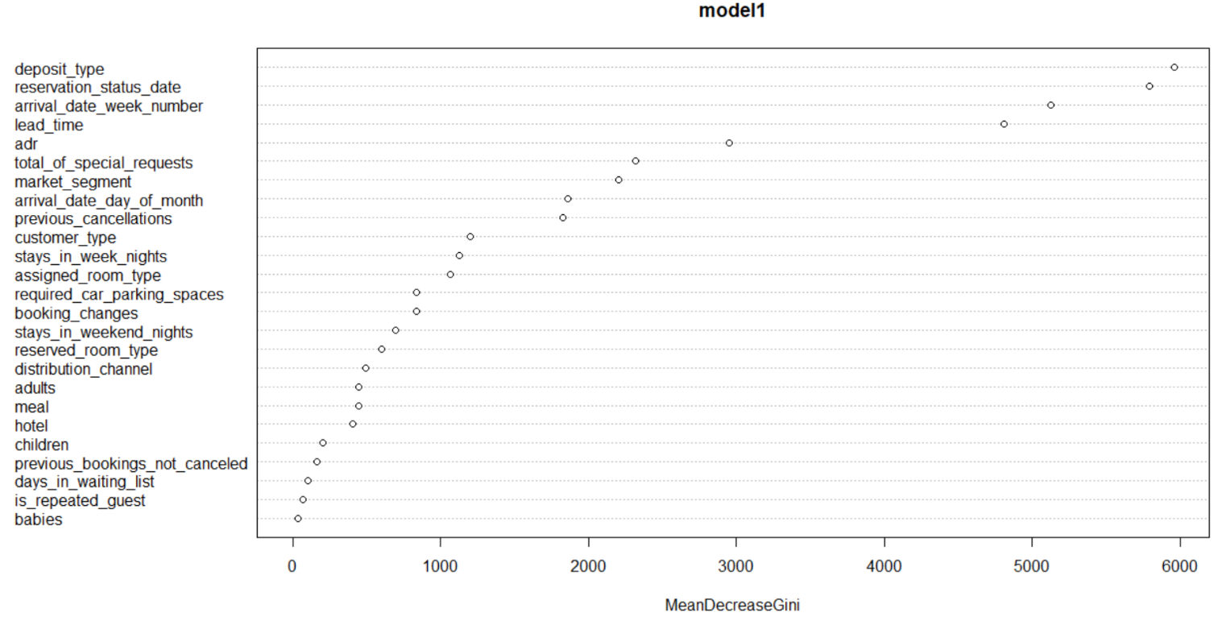
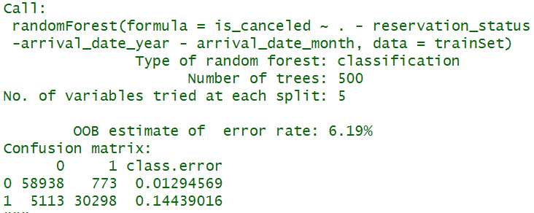
4. RANDOM FOREST
80% of the data as training data and 20% as testing.
Number of decision trees are 500 and the variable at each split is 3.
93.9% accuracy in predicting the model with testing dataset.

Slide 14
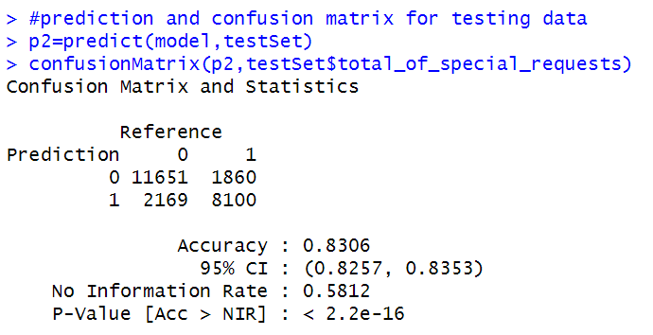
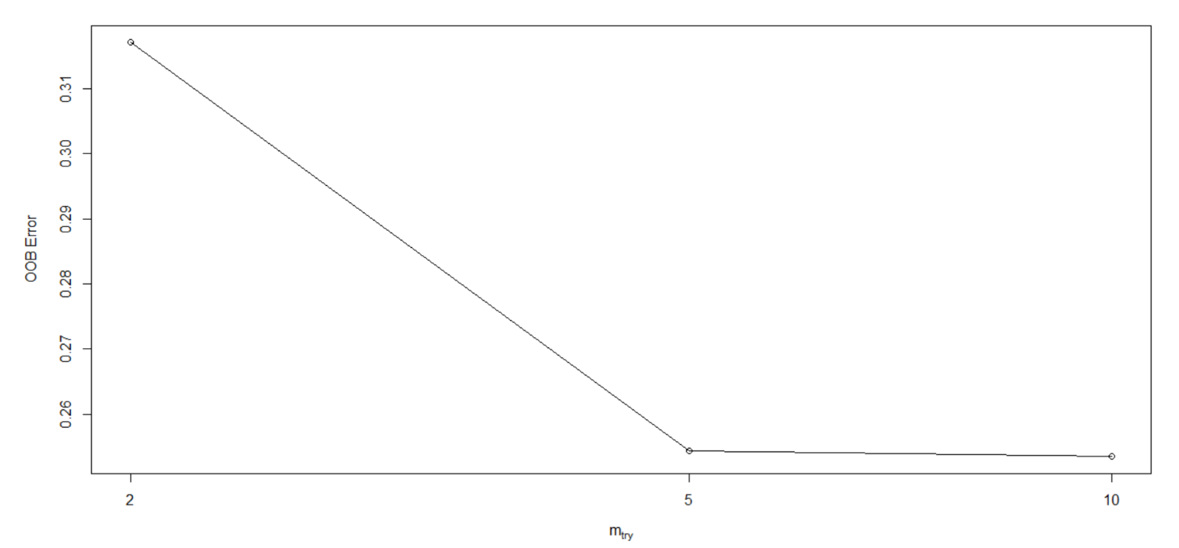
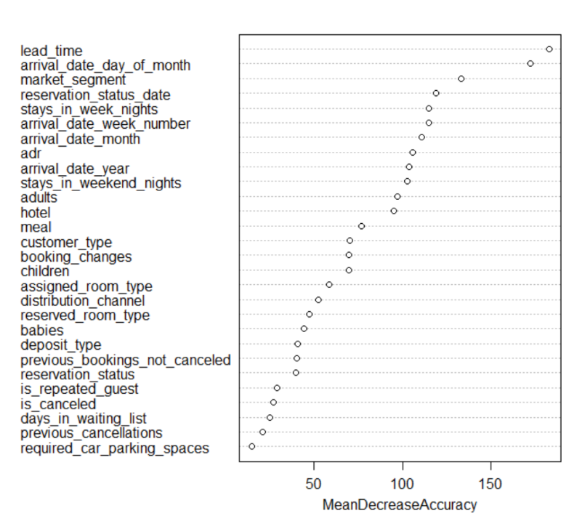
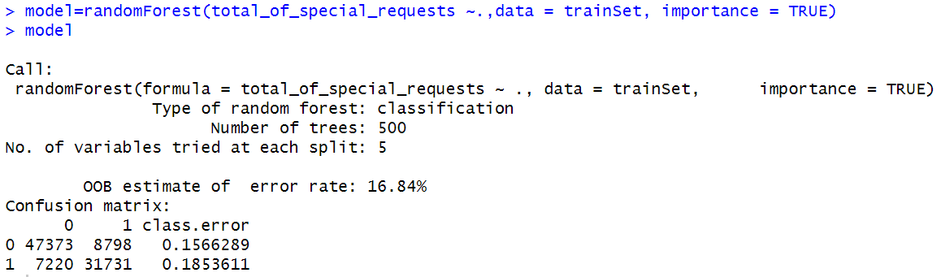
MODEL BUILDING - SPECIAL REQUEST – RANDOM FOREST
80% of the data as training data and 20% as testing.
Number of decision trees are 500 and the variable at each split is 5.
83% accuracy in predicting the model with testing dataset.
Tuning the model by increasing mtry.

Slide 15
Conclusion
Booking cancellation model makes it possible for management to avoid potential cancellations with strategies such as discounts or other perks.
Special request model will reduce uncertainty in the inventory allocation and pricing decision process by predicting the likelihood of getting a request from customers.
The repeated guests are a mere 3% ,which points a change in marketing and hospitality.
The prediction model helps to mitigate revenue loss and the risks associated with overbooking.

Slide 16
THANK YOU

